Slide 1
Heat transfer
Thermal boundary layer

Slide 2
Thermal Boundary Layer
When the temperature of a fluid flowing on a surface is different from that of the surface, a 'thermal boundary layer' develops on the surface, in a manner similar to the development of the velocity boundary layer
Let the flat plate be at a temperature of T_{s}. Let T_{a} > T_{s}. Then, the first layer that comes in contact with the surface will adhere to the surface and reach thermal equilibrium with the surface and attain a temperature of T_{s}
Then, the fluid particles in this layer will exchange energy with the particles in the adjoining layer, and so on. Thus a temperature profile will develop in the flow field and the temperature will vary from T_{s} at the surface to T_{a} at the free stream.
The region in which the temperature variation in the y-direction is significant is known as 'thermal boundary layer'.

Slide 3
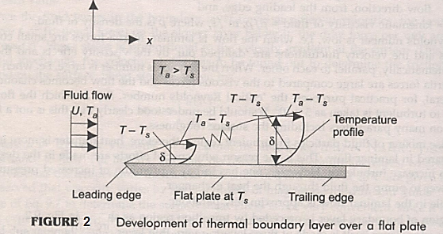

Slide 4
velocity profile in the hydrodynamic boundary layer depends on the viscosity of the fluid, whereas temperature profile in the thermal boundary layer depends on the viscosity, specific heat and thermal conductivity of the fluid, in addition to the velocity.
Relative magnitudes of the thicknesses of the hydrodynamic boundary layer ($δ$) and thermal boundary layer ($δ_{t}$) depend on the dimensionless parameter 'Prandtl number' defined as:
$pr = (Molecular diffusivity of momentum)/(Molecular diffusivity of heat)$
Or,
$$pr=\frac{v}{α}=\frac{μ.C_{p}}{k}$$
Where$μ$ is dynamic viscosity, $C_{p}$ is the specific heat and k is the thermal conductivity of the fluid. Also, $v$ is kinematic viscosity = , and $α$ is the thermal diffusivity.

Slide 5
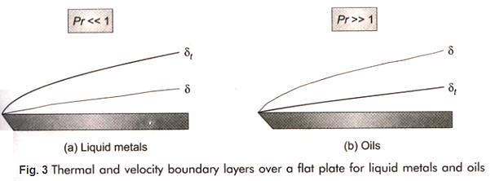
For gases, where Pr = ($v/α$) is of the order of 1
For liquid metals since Pr << 1,
For heavy oils (Pr >> 1),

Slide 6
Relation between the fluid friction and heat transfer coefficient in laminar flow for a flat plate.
Recollect that the average Nusselt number for laminar flow over a flat plate is given by: $${Nu}_{a}=0.664.\sqrt{{Re}_{L}}.{Pr}^{0.333}$$
This can be rewritten as:
$$\frac{{Nu}_{a}}{{Re}_{L}.Pr}=0.664.{{Re}_{L}}^{− \frac{1}{2}}.{Pr}^{− \frac{2}{3}}$$
Or:
$${St}_{a}=0.664.{{Re}_{L}}^{− \frac{1}{2}}.{Pr}^{− \frac{2}{3}}$$
Where ${St}_{a}$ is dimensionless number known as "Stanton number", ${St}_{a}=\frac{h_{a}}{ρ.Cp.U}$
We can write:
$${St}_{a}.{Pr}^{\frac{2}{3}}=0.664.{{Re}_{L}}^{−\frac{1}{2}}………….a$$
We already know that:
$$C_{fa}=\frac{1.328}{\sqrt{{Re}_{L}}}$$
$$\frac{C_{fa}}{2}=0.664.{{Re}_{L}}^{−\frac{1}{2}}……….b$$
Comparing Eqs. a and b, we can write:
$${St}_{a}.{Pr}^{\frac{2}{3}}=\frac{C_{fa}}{2}$$

Slide 7
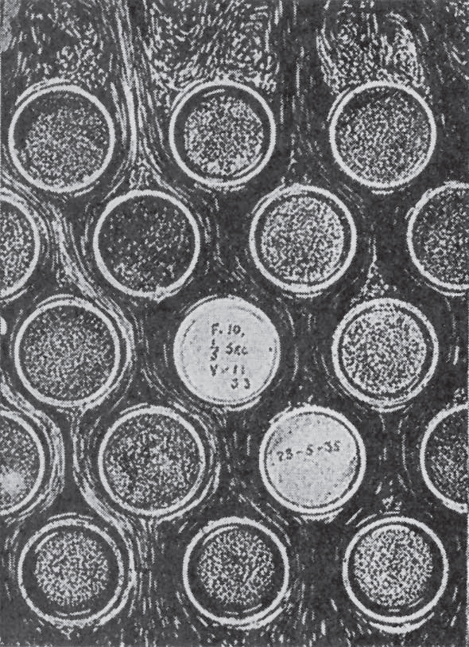

Slide 8
